Slide 1
Downingtown Area Robotics
www.team1640.com
www.darobotics.org

Slide 2
What do we do?
Inspire young people to pursue STEM careers
Engage students with competitive robotics based on a sports model
(4) programs covering K-12
Programs organized by FIRST®
For Inspiration and Recognition of Science and Technology
Serve the Chester County Area
Flagship is our High School robotics team

Slide 3
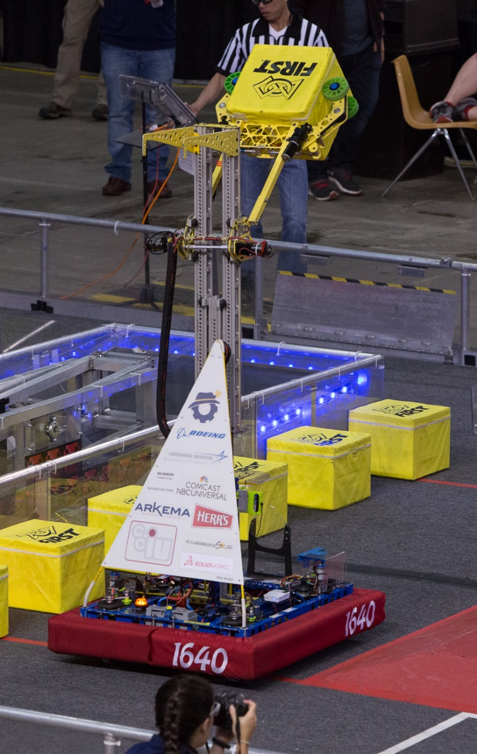
FIRST® Robotics Competition
High School students
Mentor-guided
Robots are large & complex
Time, cost & weight constrained
Both highly competitive & cooperative (coopertition)
Gracious Professionalism

Slide 4
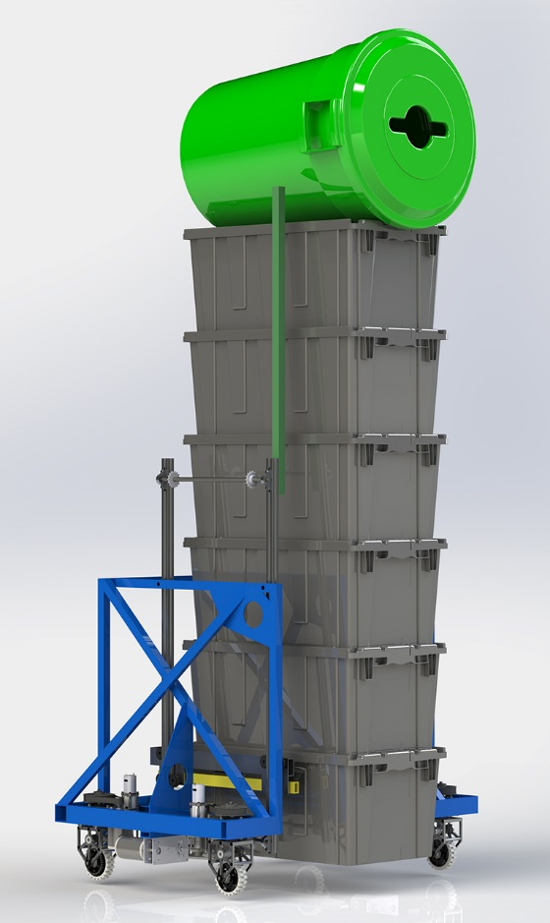
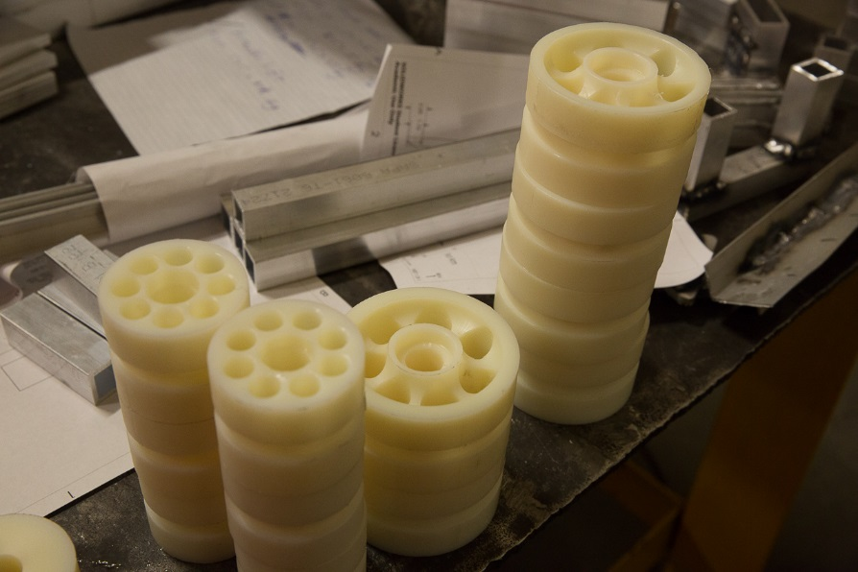
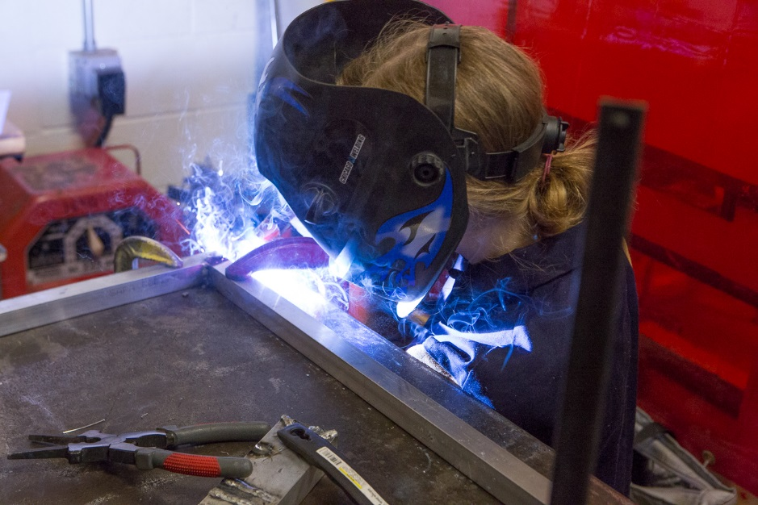
What do Students do?
Develop Strategy & plan
Test concepts; prototype
Design
Specify parts & materials
Develop control software
Develop scouting software
Build a Practice Field
Fabricate (cut, mill, print) parts
Lay up composites
Weld (Al)
Assemble; Wire
Test

Slide 5
Skill Development
Critical Analysis
Problem Solving
Communications
Leadership
CAD (SolidWorks)
Programming (JAVA)
Wiring
Soldering
Composite Manufacture
MIG Welding
Mill Operation
CNC Lathe Operation
CNC Router Operation
3D Printing
Basic Power Tool Use
Carpentry

Slide 6
Caveats
We graduate 10 or so students per year
Most will go on to University
Most of these will become Engineers, Programmers, Scientists, Entrepreneurs, Business persons and Marketers

